Slide 1
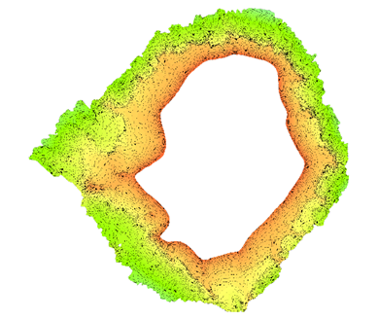
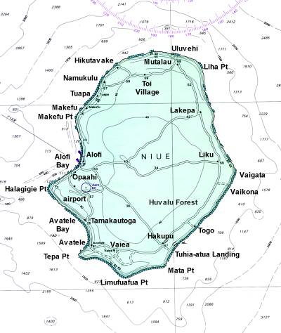
16th South West Pacific Hydrographic Commission Meeting NIUE

Slide 2
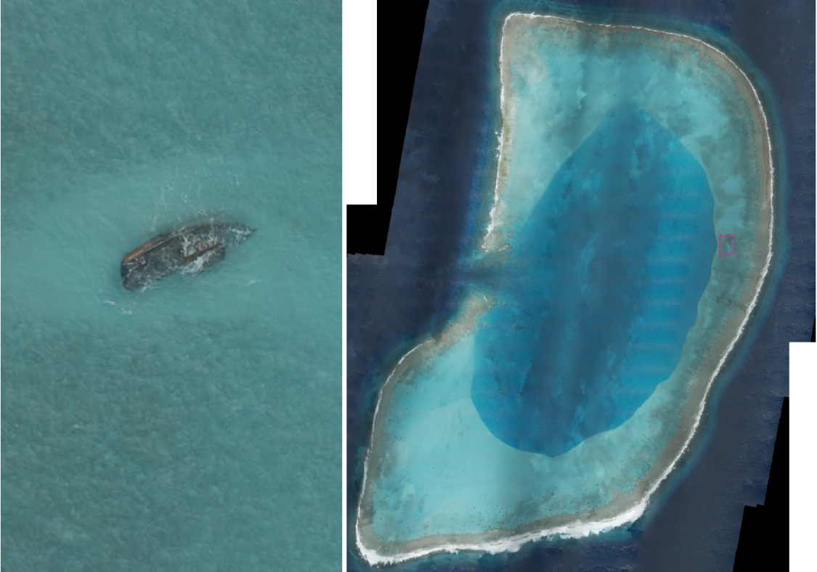
Main achievements
SDB of Niue, Beveridge Reef
and Antiope Reef
LiDAR Survey of Niue and
Beveridge Reef

Slide 3
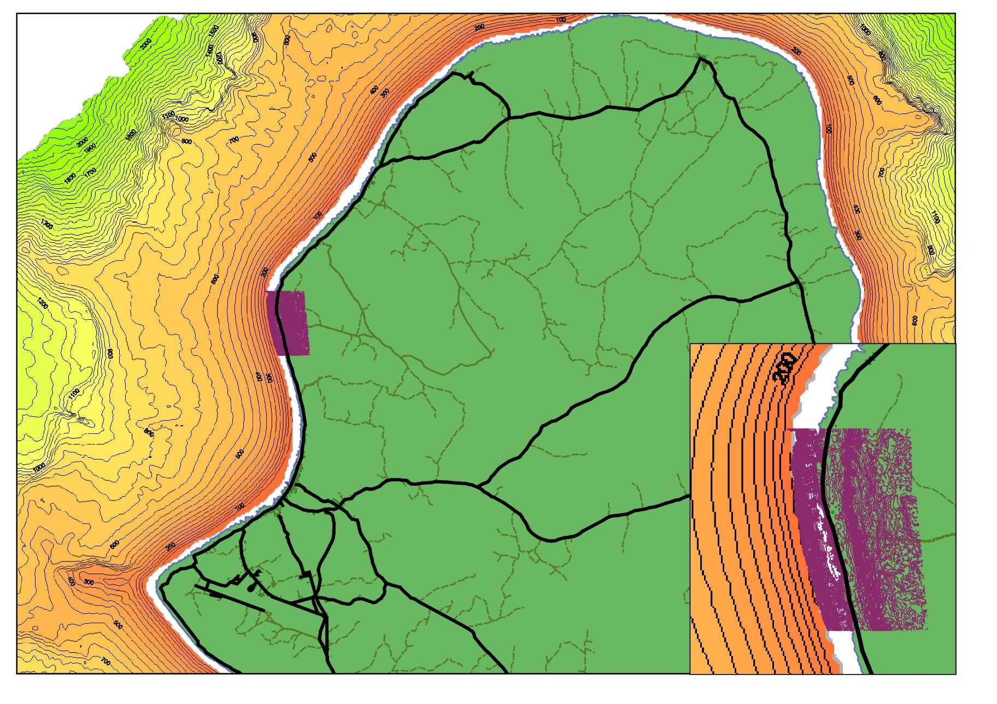
Main achievements

Slide 4
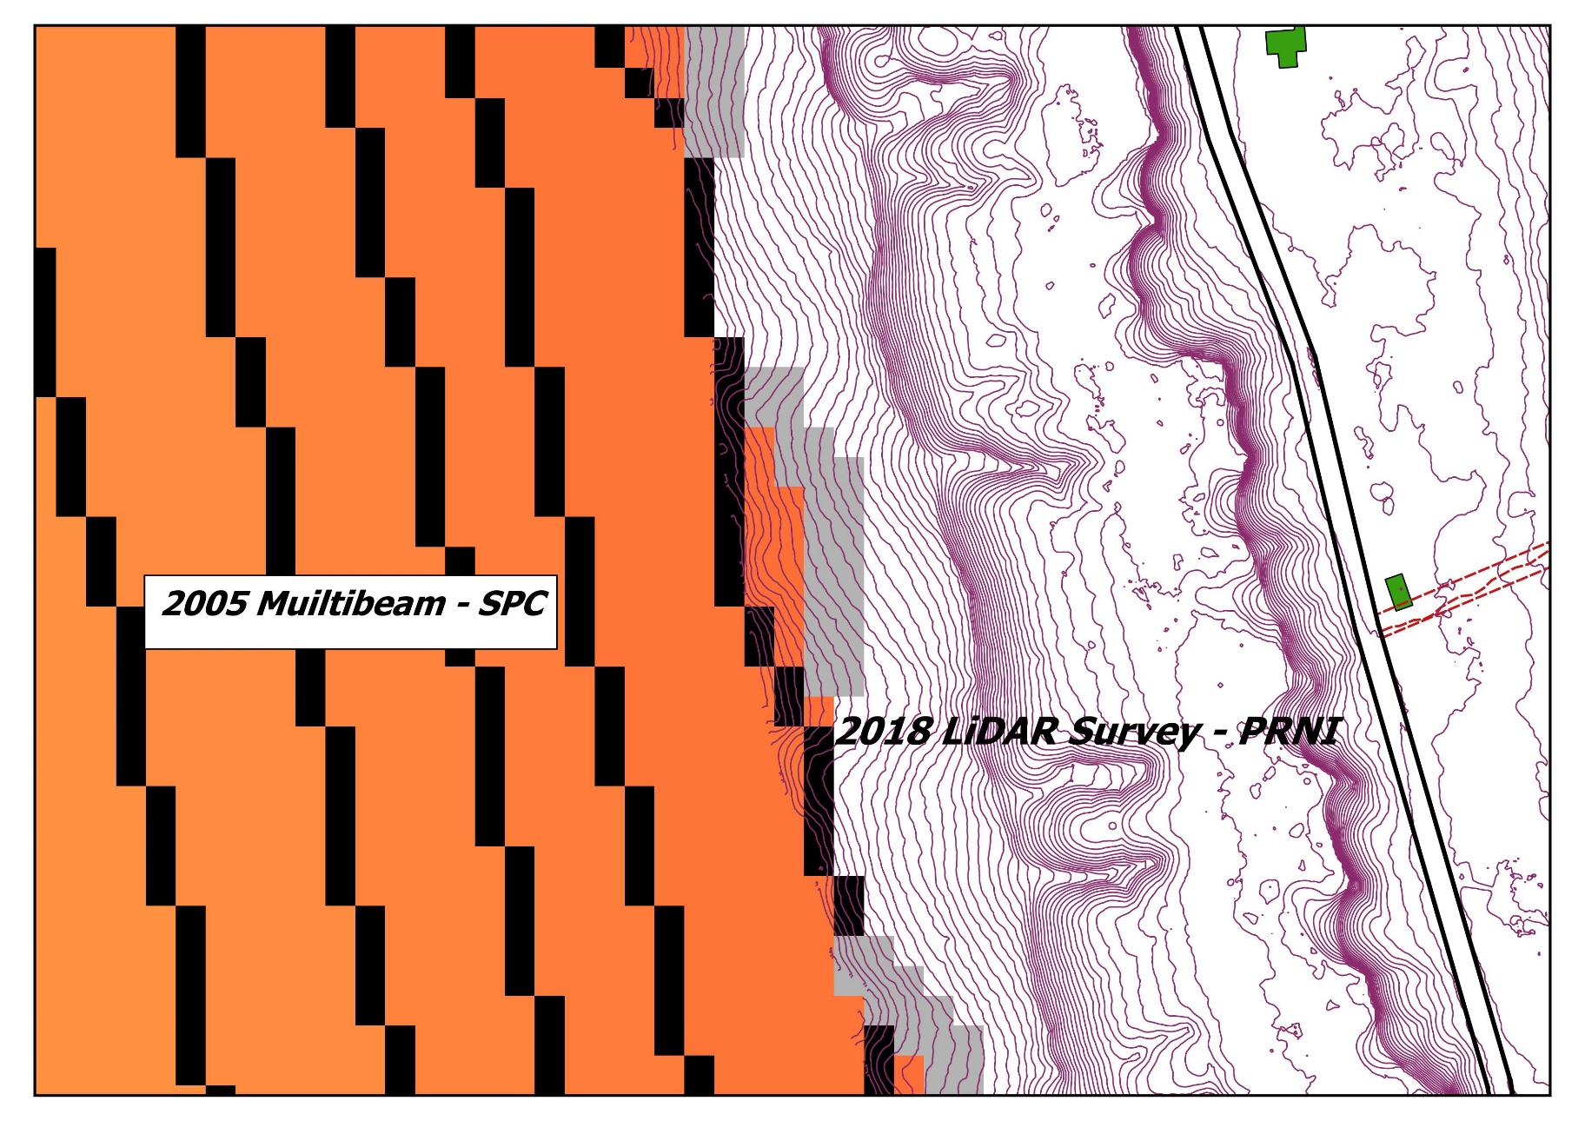
Main achievements

Slide 5
Main achievements
Marine Spatial Management Plan
Legal Framework Analysis

Slide 6
Main challenges
MSI
Retention of staff after training

Slide 7
Future Focus
AToN Risk Assessment (18 – 22 Feb 2019)
IHO Technical Implementation Visit in 2019
Updated chart for Niue and new plan for Beveridge Reef in early 2020
Marine Spatial Plan, compliance strategy and sustainable financing
Draft legislation to implement the IMO conventions
Manatua Submarine Cable Project (2020)

